Slide 1

Getting Started with SQL

Slide 2
Objectives
Demonstrate how to write basic SQL statements
Describe SQL and Databases
Create and execute CREATE TABLE, SELECT, INSERT, and DELETE SQL statements with a live database
Getting Started with SQL

Slide 3
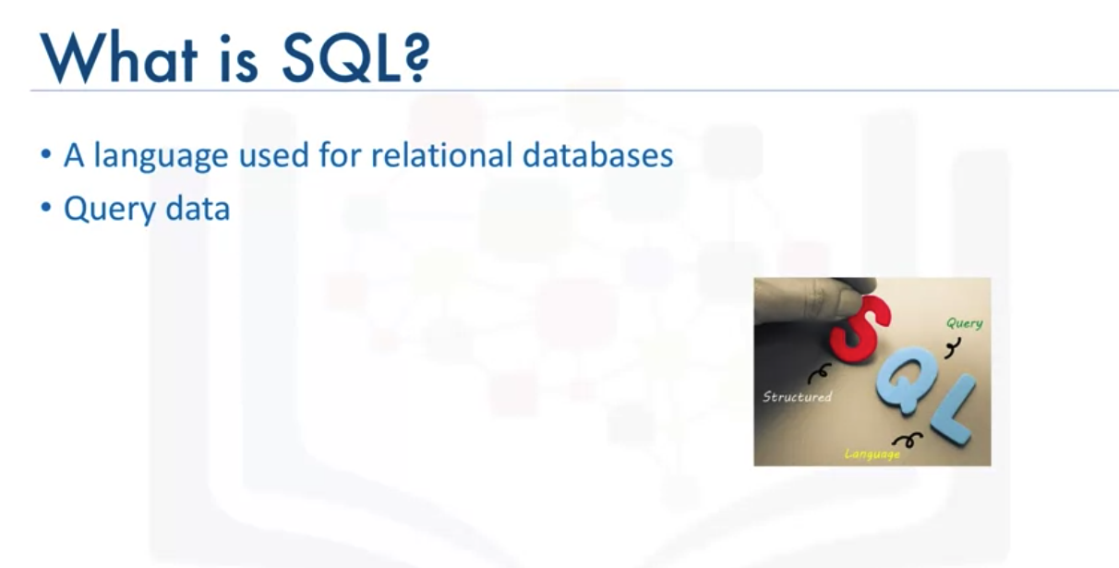
Introduction to Databases
Getting Started with SQL

Slide 4

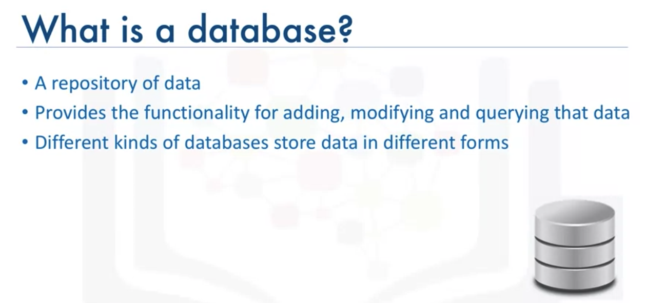
Introduction to Databases
Getting Started with SQL

Slide 5
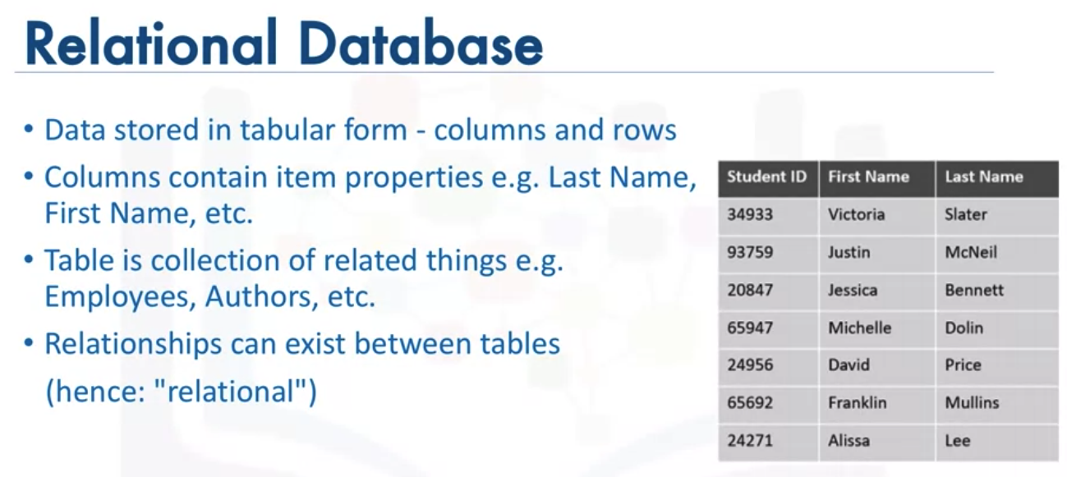
Introduction to Databases
Getting Started with SQL

Slide 6
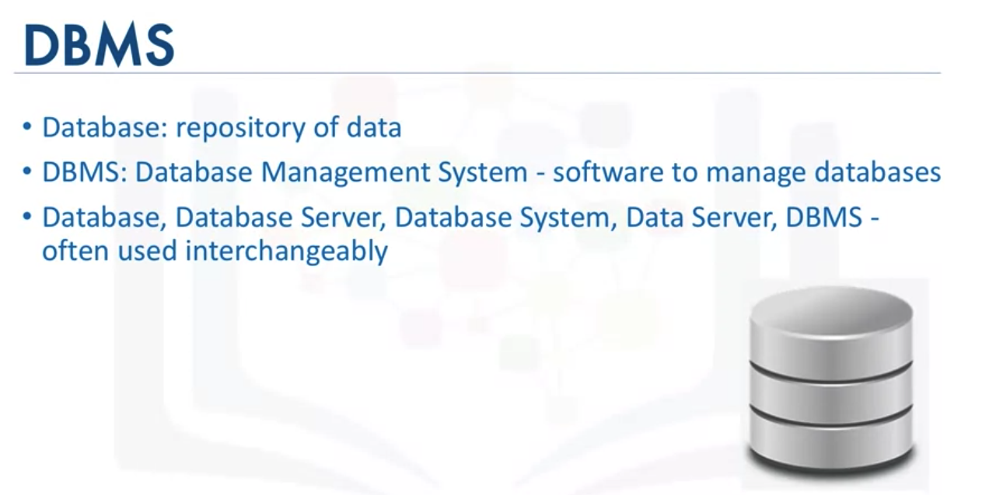
Introduction to Databases
Getting Started with SQL

Slide 7
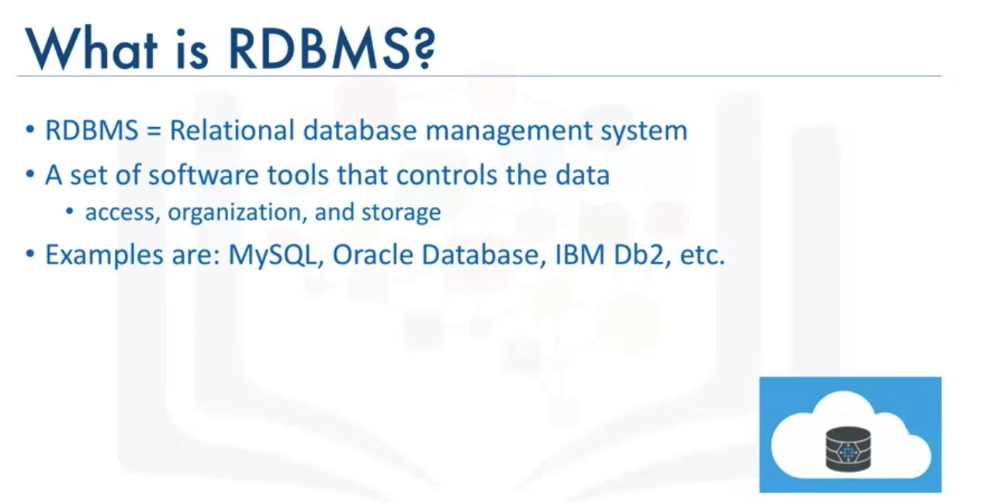
Introduction to Databases
Getting Started with SQL

Slide 8
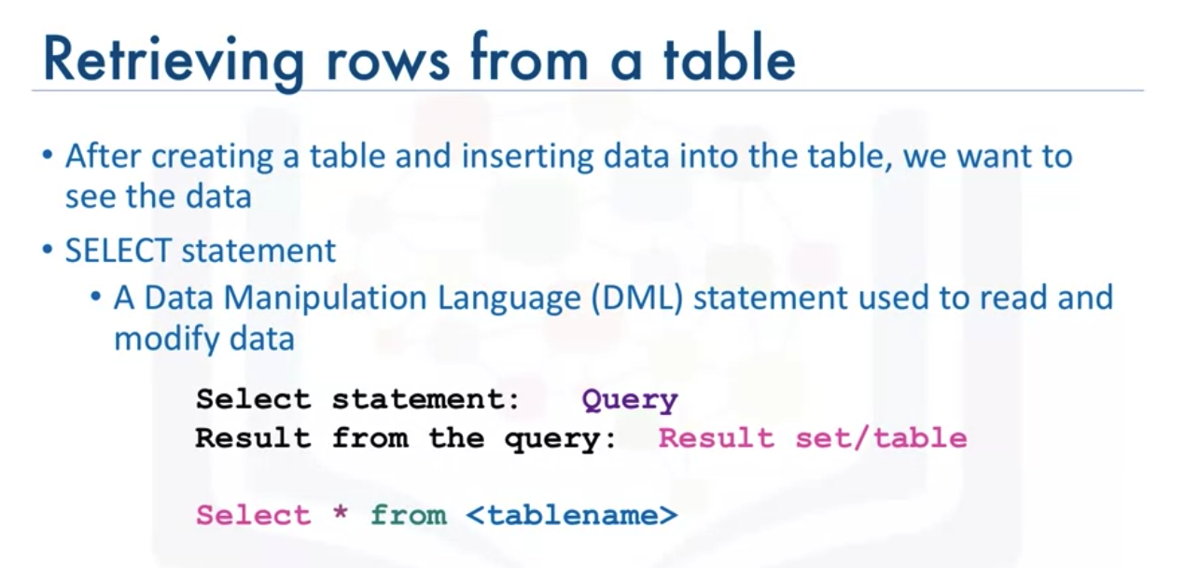
SELECT
Getting Started with SQL

Slide 9
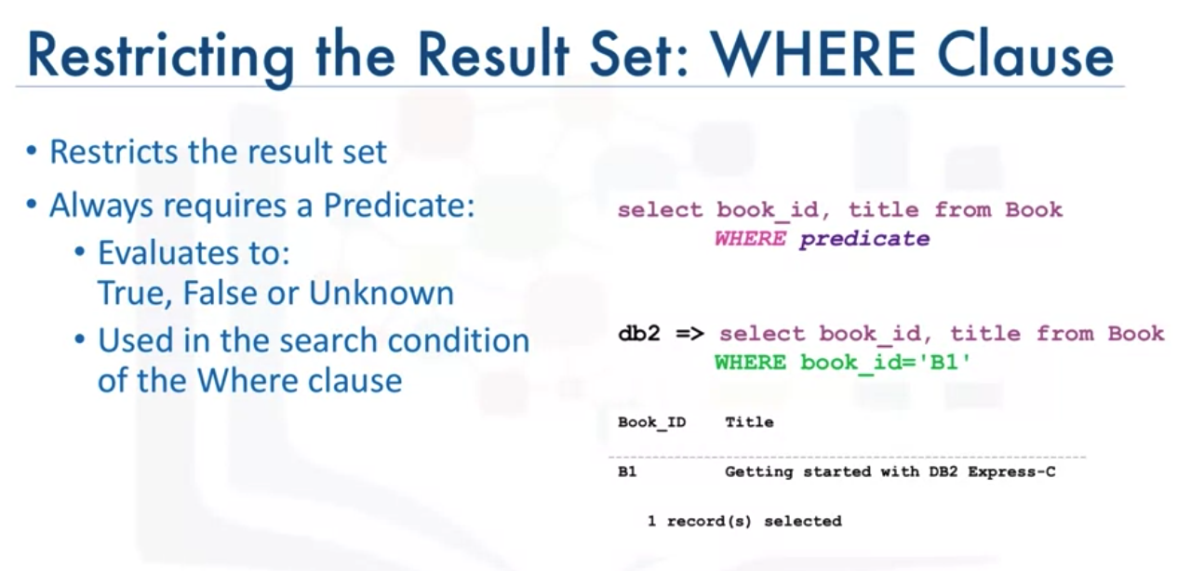
SELECT
Getting Started with SQL

Slide 10
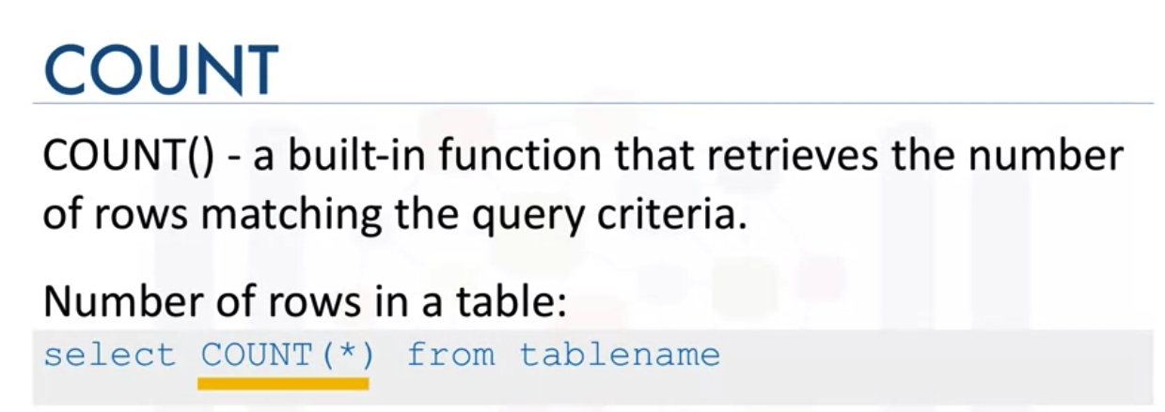
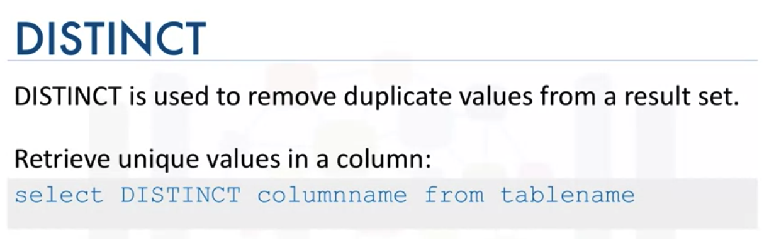
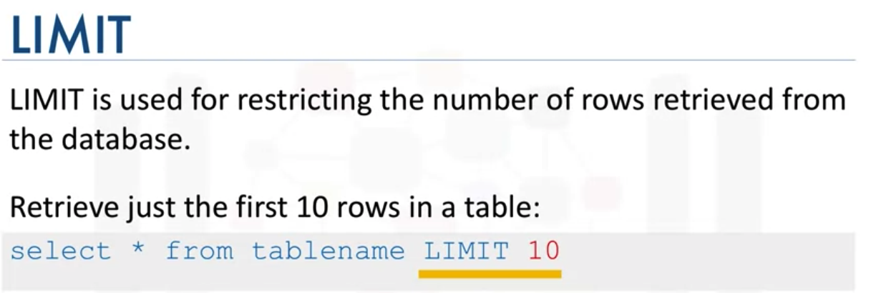
COUNT, DISTINCT, LIMIT
Getting Started with SQL

Slide 11
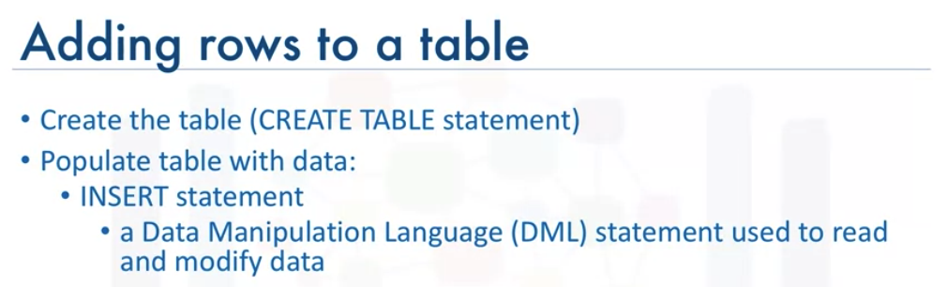
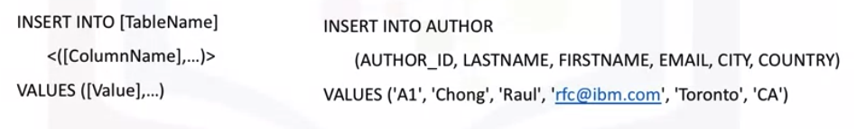
INSERT
Getting Started with SQL

Slide 12
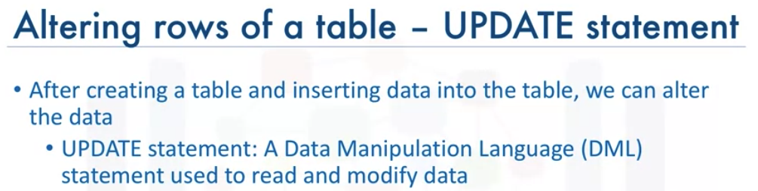
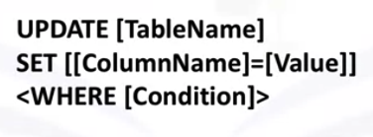
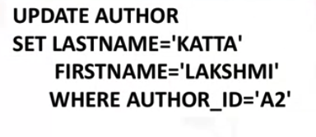
UPDATE
Getting Started with SQL

Slide 13
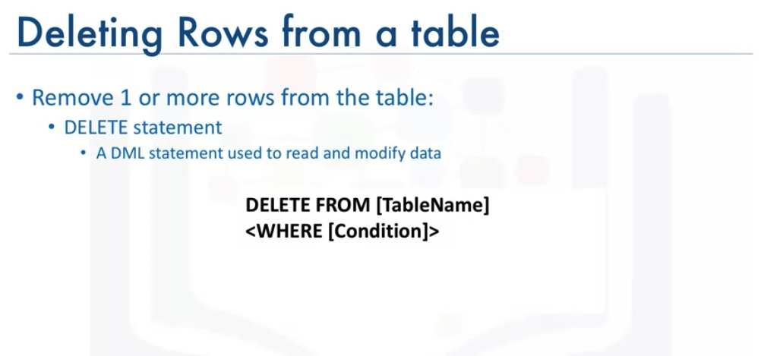

DELETE
Getting Started with SQL

Slide 14
Summary
Demonstrate how to write basic SQL statements
Describe SQL and Databases
Create and execute CREATE TABLE, SELECT, INSERT, and DELETE SQL statements with a live database
Getting Started with SQL

Slide 15
Q & A
Getting Started with SQL

